Slide 1
Components of .net
Muhammad Faisal Akram
MS(CS) Software Engineering
0322-7015352

Slide 2
Components of .Net Framework
CLR (Common Language Runtime)
CTS (Common Type System)
CLS (Common Language Specification)
CLASS LIBRARIES
ADO.NET
ASP.NET

Slide 3
Introduction to CLR in .Net Framework
The main function of CLR is to convert the Managed Code into native code and then execute the program.
When .Net application is executed at that time control will go to OS, the OS create a process to load CLR.
Following are the functions of CLR:
Handles Exceptions
Provide type-safety
Memory Management
Garbage Collection

Slide 4
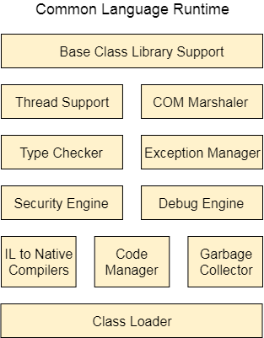
Structure to CLR

Slide 5
Structure of CLR
Base Class Library Support
Provides the support of classes to .NET application.
Thread Support
It manages parallel execution of multi-threaded application
COM Marshaler
It provides communication between COM objects and the application
Type Checker
It checks types used in application and verifies that they match to the standards provided by the CLR.

Slide 6
Structure of CLR
Code Manager
Manages the code at run-time.
Garbage Collector
It releases the unused memory & allocates it to new application.
Exception Handler
It handles the exception at runtime to avoid application failure.
Class Loader
It is used to load all classes at run time.

Slide 7
QUIZ & ASSIGNMENT

